Slide 1

CSCI 466: Networks
Introduction, Syllabus, and Logistics
Reese Pearsall
Fall 2024
https://www.cs.montana.edu/pearsall/classes/fall2024/466/main.html

Slide 2
https://www.youtube.com/watch?v=2c6pQDfFacY

Slide 3


Communication in the Digital Era

Slide 4

Communication in the Digital Era

Slide 5


Communication in the Digital Era
“Hello, John!”

Slide 6


Communication in the Digital Era

Slide 7

Communication in the Digital Era

Slide 8


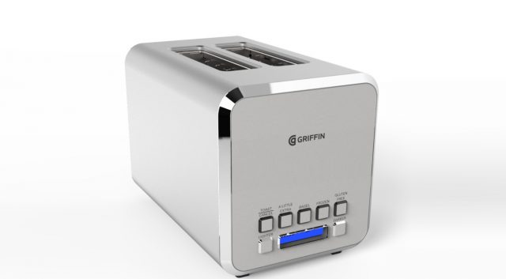


Communication in the Digital Era

Slide 9


Communication in the Digital Era

Slide 10







Communication in the Digital Era

Slide 11
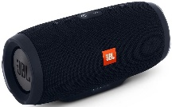


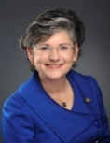




Communication in the Digital Era

Slide 12

Communication in the Digital Era

Slide 13
Communication in the Digital Era

Slide 14
Communication in the Digital Era

Slide 15

Communication in the Digital Era

Slide 16
Communication in the Digital Era
There were 5.3 billion active internet users around the world in 2023
We have billions of devices that are constantly communicating with one another
Internet users* make trillions of web requests per day
Facebook generated four petabytes of data every day in 2023.
______ account for over 80% of internet traffic

Slide 17
Communication in the Digital Era
There were 5.3 billion active internet users around the world in 2023
We have billions of devices that are constantly communicating with one another
Internet users* make trillions of web requests per day
Facebook generated four petabytes of data every day in 2023.
Video Content account for over 80% of internet traffic

Slide 18
Communication in the Digital Era

Slide 19
Communication in the Digital Era
???

Slide 20

Communication in the Digital Era
The Internet

Slide 21
Communication in the Digital Era
How does computer A send a message to computer B?
The Internet

Slide 22

Communication in the Digital Era
How does computer A send a message to computer B?
The Internet
“Packet”

Slide 23
Communication in the Digital Era
How does computer A send a message to computer B?
The Internet
“Packet”
Doesn’t create congestion
Where to?
Not corrupted
On time
Guaranteed Delivery
Safely

Slide 24
Communication in the Digital Era
How does computer A send a message to computer B?
The Internet
There are layers or steps that describe the process for communicating over a computer network

Slide 25
Communication in the Digital Era
What are the different ways to design a computer network?
The Internet

Slide 26
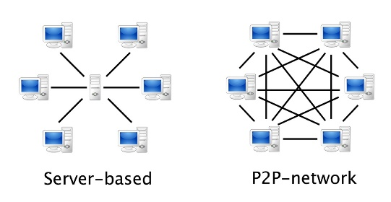

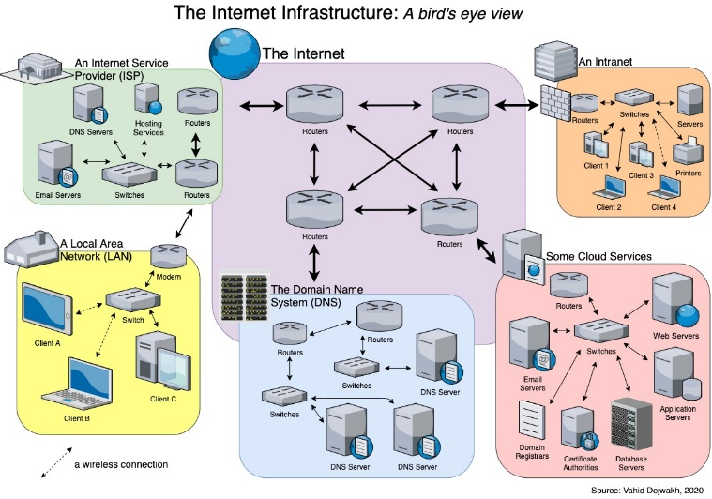
Communication in the Digital Era
What are the different ways to design a computer network?
The Internet

Slide 27
Communication in the Digital Era
What are the rules and protocols for communicating over a network?
The Internet

Slide 28
Communication in the Digital Era
What are the rules and protocols for communicating over a network?
The Internet
HTTP
IP
UDP
TCP
SMTP
DNS
SSH
FTP
OSPF
BGP

Slide 29
Communication in the Digital Era
How can we measure the performance or efficiency of a network?
The Internet

Slide 30
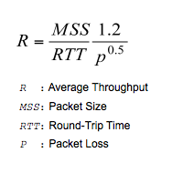
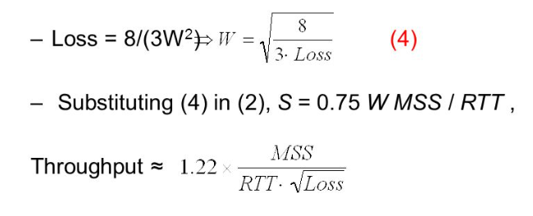
Communication in the Digital Era
How can we measure the performance or efficiency of a network?
The Internet

Slide 31



Communication in the Digital Era
How can we make our communications safe and trustworthy?
The Internet

Slide 32

CSCI 466- Course Outcomes
List the network layers and explain their function in end-to-end communications
Explain the functions of various Network protocols (HTTP, DNS, TCP/IP, BGP, etc)
Design and implement network applications
Analyze network traffic
Understand important security mechanisms in networks
Understand what the cloud is and how to implement and deploy a simple cloud application

Slide 33
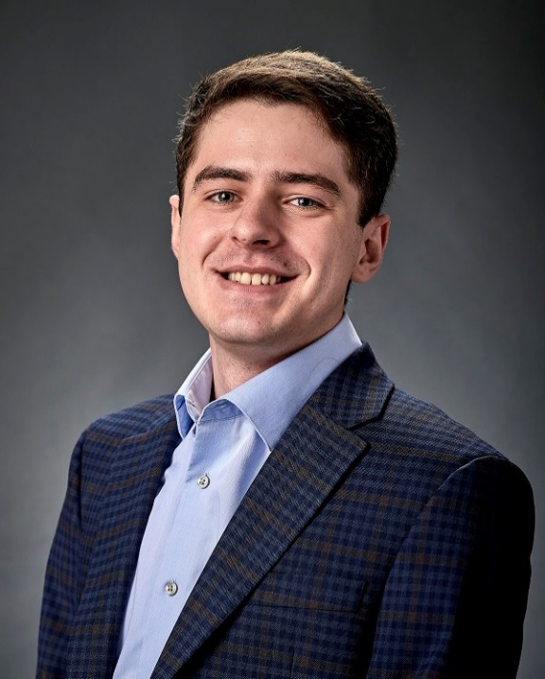
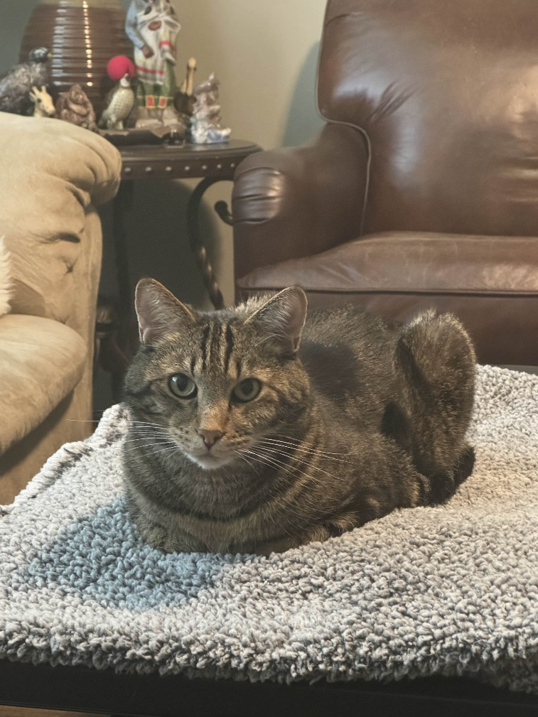



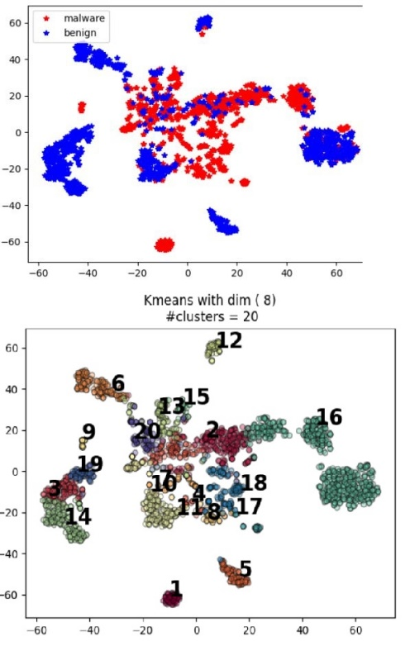
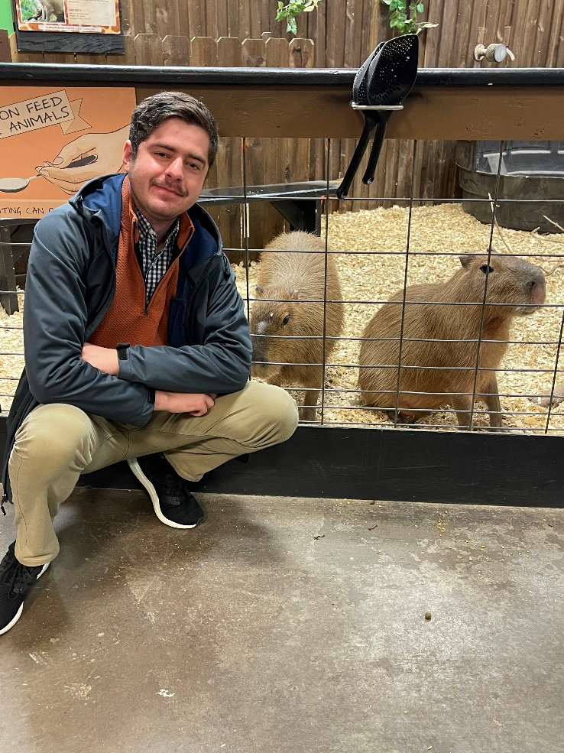
Reese Pearsall
(pierce-all)
Third year Instructor @MSU
B.S & M.S @ MSU
Hometown
Billings, MT
Interests
Cybersecurity
Malware analysis and detection
Cybercrime
Computer Science Education
Meatball
Teaching
CSCI 132
CSCI 466
CSCI 476
Mario Kart Character
Wario
Experience
Software Engineer and Tester, Techlink (Bozeman)
Software Engineer, United States Air Force (Hill AFB, Utah)
Cybersecurity Software Engineer, Hoplite Industries (Bozeman)
Graduate Researcher, MSU (Bozeman)
Outside of academia
Video games, New England Patriots, Fantasy Football, TikTok, Garfield, Dr Pepper, Memes, The Bachelor, Naps

Slide 34

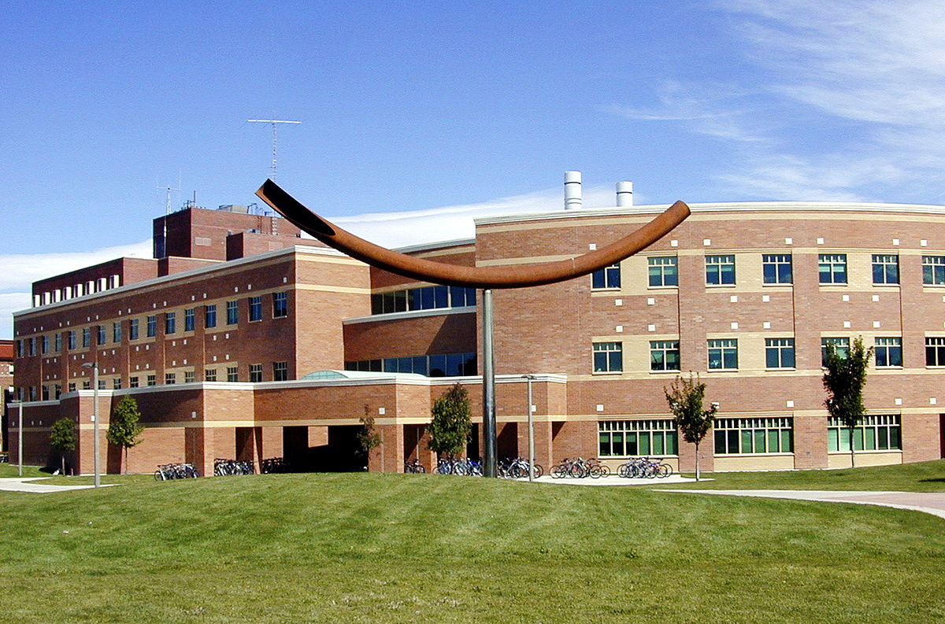


Contact
Email: reese.pearsall@montana.edu (I will respond as soon as I can)
Office Hours: Monday, Wednesday, Thursday, Friday 1:00 PM – 2:00 PM
Office: Barnard Hall 361
(my office will generally still be open after 2:00)
I am also very responsive on Discord!
(@reese_p)

Slide 35
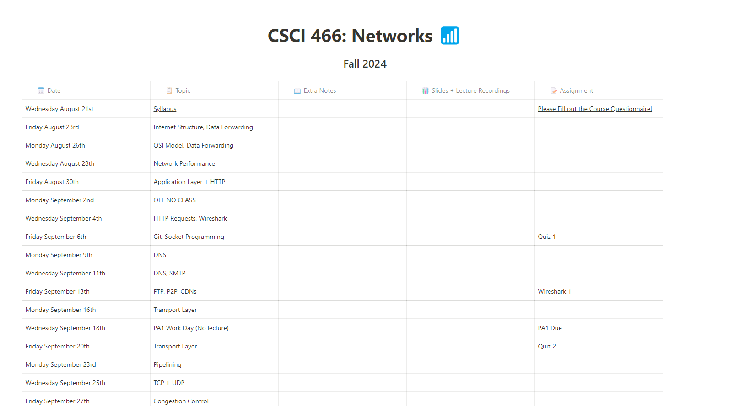



Logistics
Class Meetings
MWF: 12:00 – 12:50 PM
Norm Asbjornson Hall 137
Course Website: https://www.cs.montana.edu/pearsall/classes/fall2024/466/main.html
We will be using Discord for class communication and for announcements

Slide 36
Prerequisites
• CSCI 232- Data Structures and Algorithms
• CSCI 112- Programming with C
• CSCI 366- Computer Systems (recommended)
Before taking this class, I expect you to be comfortable with:
• Python
• Writing and debugging programs of moderate complexity
• Git & Github (we will likely review this)

Slide 37

Schedule

Slide 38
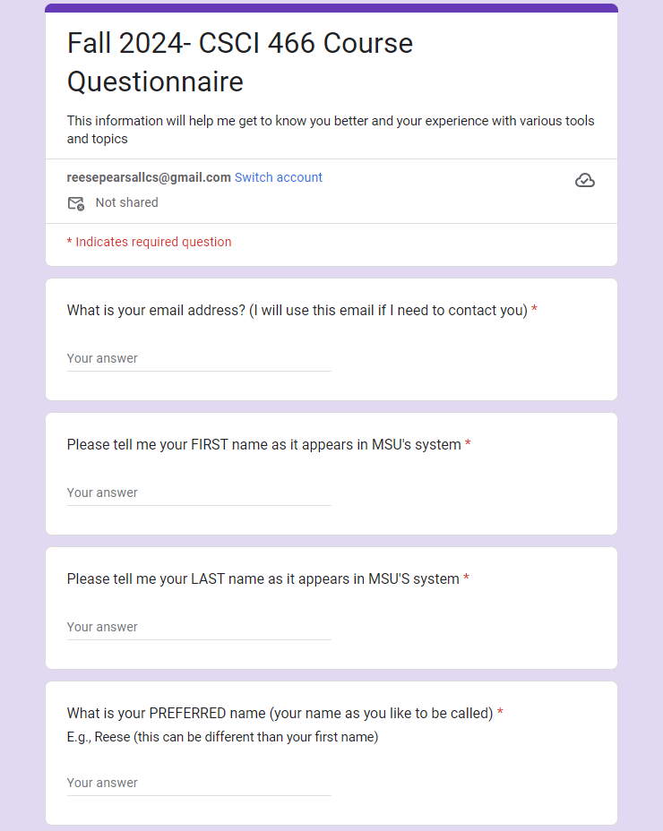

Course Questionnaire
Please take some time to do the course questionnaire today or tomorrow
Your answers are important to me, and will help make this class a better experience

Slide 39
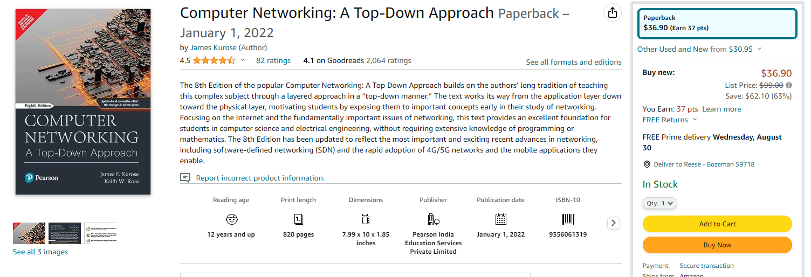
Textbook
(optional)
I will not require you to get the textbook, but it is a great resource for learning the material and doing the assignments
(currently not in the bookstore)

Slide 40

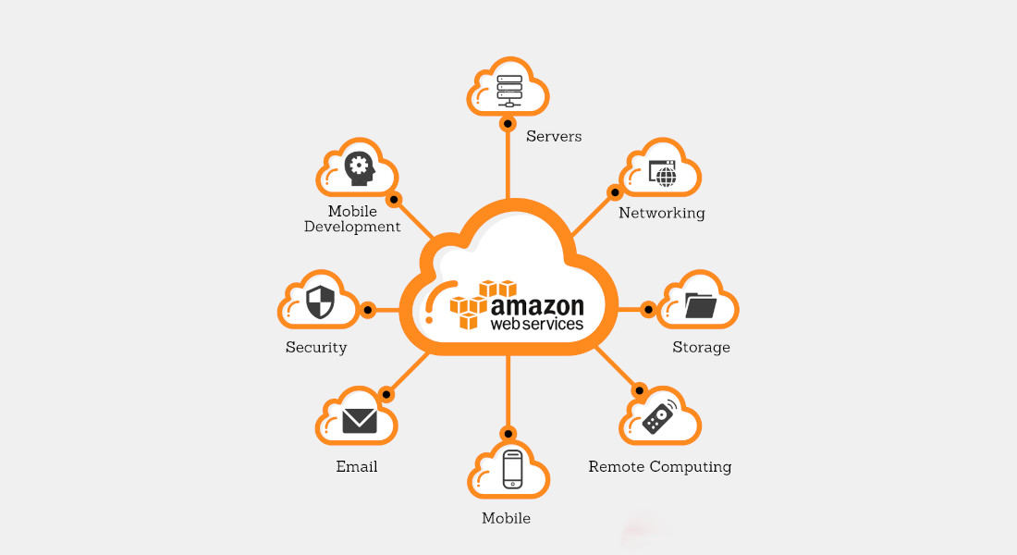
Cloud Computing
We are going to try to work with Amazon Web Service (AWS) later this semester
Getting a cloud server up and running may cost (a very small) amount of money
Therefore, you may need to have a valid payment option (credit card, etc)

Slide 41
Grading
40% Programming Assignments (5)
30% Wireshark Labs (5)
20% Quizzes (6)
10% Final Quiz

Slide 42
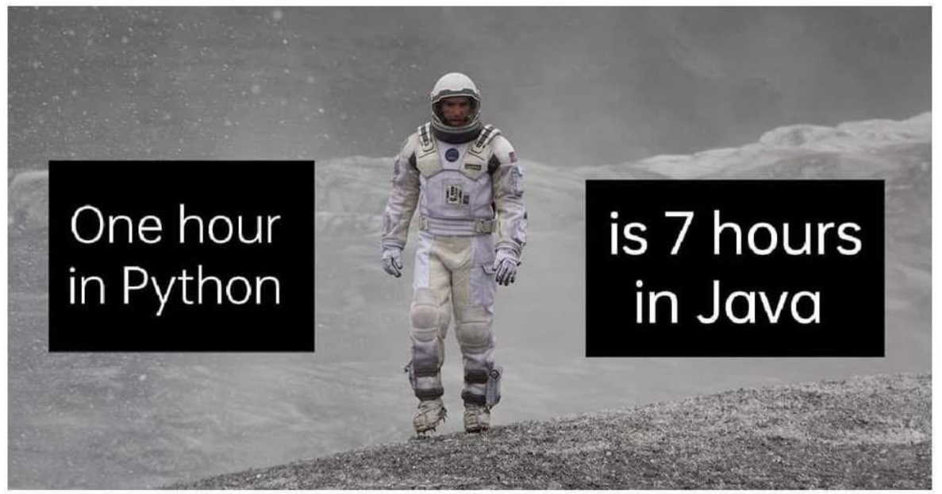
Grading Breakdown
40% Programming Assignments (5)
Create network applications using a language of your choice
Requires a good chunk of your time
You will place your assignments in a private GitHub repository and submit the repo link to D2L
You will record a short video demo showcasing the functionality of your program
You are allowed to work with one or two partner(s) (encouraged)

Slide 43

Grading Breakdown
30% Wireshark Labs (5)
Analyze real network traffic and see network concepts and protocols in action
Follow instructions using Wireshark and document your findings and observations in a word document
Submit report to D2L as a PDF
You are allowed to work with one partner (encouraged)

Slide 44
Grading Breakdown
20% Quizzes (6)
Every other week, there will be a quiz on Friday
Tests your knowledge on basic networks concepts we talk about in lecture
Administered via Brightspace (multiple choice, auto-graded)
Quizzes will be open for an 8 hour window, not timed.
I’ll drop your lowest quiz grade
Should only take around 15 minutes

Slide 45
Grading Breakdown
10% Final Quiz
Only two questions
Cumulative quiz that evaluates your knowledge of the entire semester
Question 1: You will be asked to document and label the layers and aspects of the OSI model
Question 2: Secret
Note sheet not allowed
Will take place on the final class meeting (Dec 6)

Slide 46
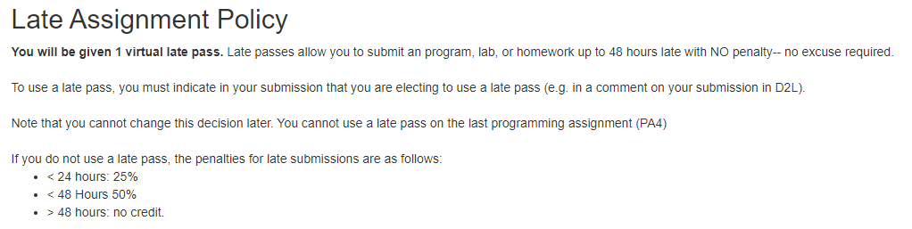
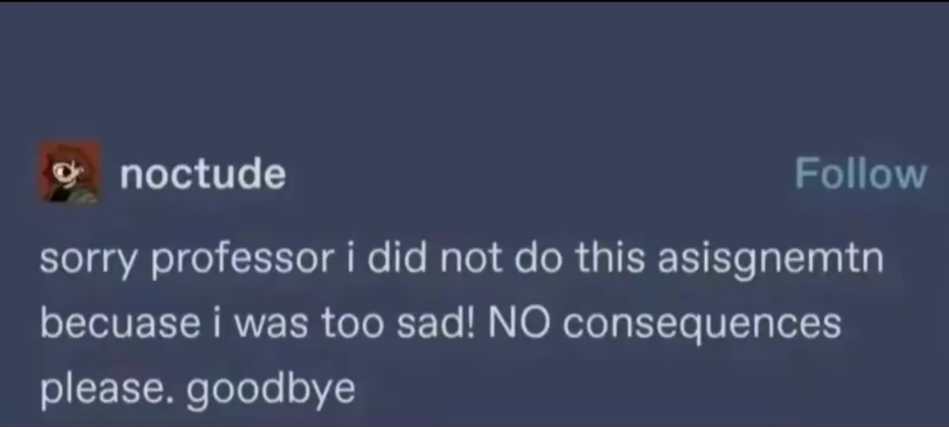
Late Assignment Policy
You get 1 late pass

Slide 47
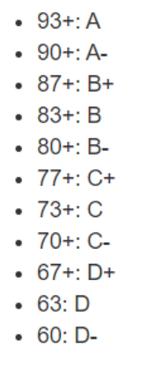
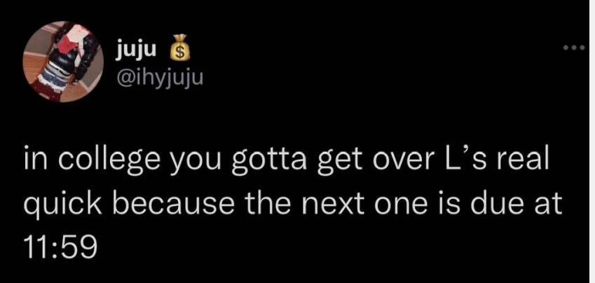
Grading Scale
At the end of the semester, if you are within 1% of the next letter grade, I will bump you up
I will not curve assignment or exam grades

Slide 48
Plagiarism, Academic Misconduct, Generative AI tools
Plagiarism and cheating is very not cool
You are not allowed to submit something that is not your own, and you are not allowed to steal solutions from another person and modify it
I have a Chegg and Course Hero membership. Don’t try it
Using small snippets of code from the internet is acceptable (but should not be needed). If you do use a small snippet of code from the internet, you should leave a reference as a comment in your code
Do not use any tools or AI that will write code or solutions for you

Slide 49

MSU Resources
https://www.cs.montana.edu/pearsall/classes/msu_resources.html

Slide 50
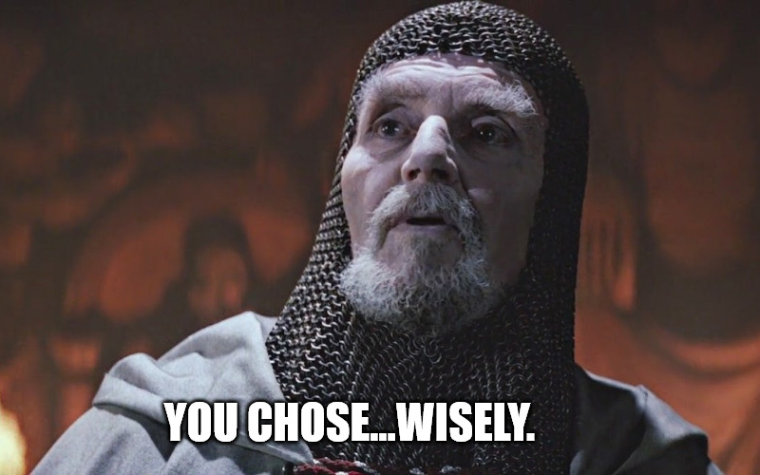
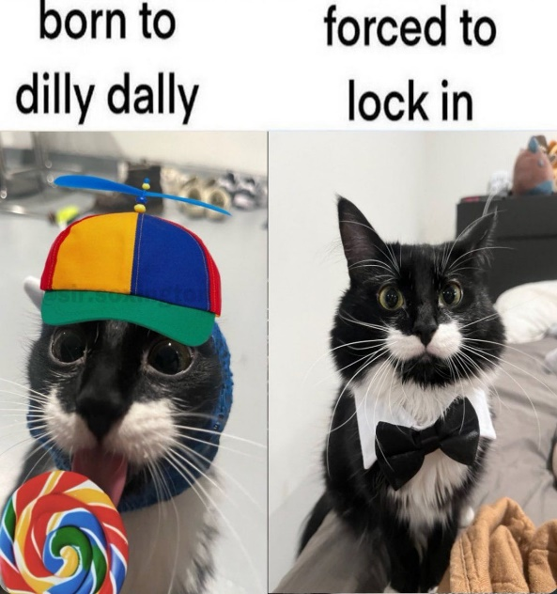
How to do well in this class
Don’t wait until the last night to do an assignment
Get help when you need it
Come to class and office hours
Take care of yourself
Have fun

Slide 51
Questions?

